Slide 1
Lecture # 1 introduction to android studio (ide)
Software Application For Mobile Devices

Slide 2



outcomes
After doing this lab student will be able to understand:
Install and configure Android Studio IDE on their computer
Navigate key features of the IDE including project structure, code editor, preview tools
Create a new Android project and application
Know-how About Activities
Add UI components like text, images to an app
Write code in languages like Kotlin and Java for Android
Run applications on emulator
Use debugging tools like the logger and breakpoints

Slide 3

Introduction to android studio
It is stated that “If you give me six hours to chop down a tree then I will spend the first four hours in sharpening the axe”. So, in the Android Development World if we consider Android Development as the tree then Android Studio should be the axe. Yes, if you are starting Android Development then you must be familiar with Android Studio i.e. the tool that is used for developing Android applications. Android Studio is the official IDE (Integrated Development Environment) for Android app development, and it is based on JetBrains’ IntelliJ IDEA software.

Slide 4

What is android studio
Android Studio is the official IDE (Integrated Development Environment) for Android app development, and it is based on JetBrains’ IntelliJ IDEA software. Android Studio provides many excellent features that enhance productivity when building Android apps, such as:
A blended environment where one can develop for all Android devices
Apply Changes to push code and resource changes to the running app without restarting the app
A flexible Gradle-based build system
A fast and feature-rich emulator
GitHub and Code template integration to assist you to develop common app features and import sample code
Extensive testing tools and frameworks
C++ and NDK support
Built-in support for Google Cloud Platform, making it easy to integrate Google Cloud Messaging and App Engine, and many more.
Provides GUI tools that simplify the less interesting parts of app development.
Easy integration with real time database ‘firebase’.

Slide 5

System requirement
Microsoft Windows 7/8/10 (32-bit or 64-bit)
4 GB RAM minimum, 8 GB RAM recommended (plus 1 GB for the Android Emulator)
2 GB of available disk space minimum, 4 GB recommended (500 MB for IDE plus 1.5 GB for Android SDK and emulator system image)
1280 x 800 minimum screen resolution

Slide 6
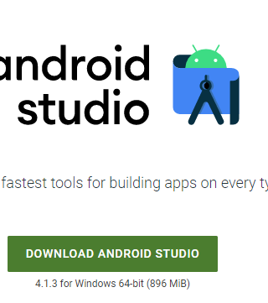
Installation guide
Step 1: Head over to this link to get the Android Studio executable or zip file.
Step 2: Click on the Download Android Studio Button.

Slide 7
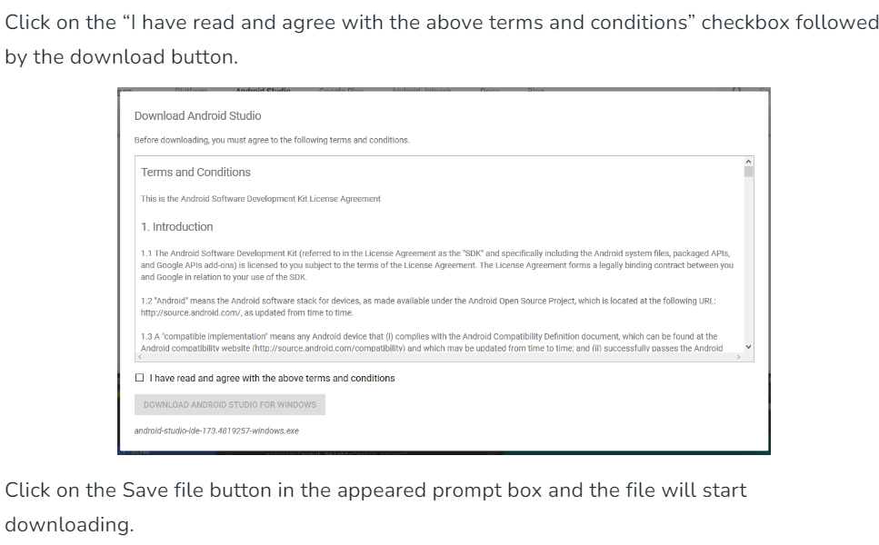

Slide 8
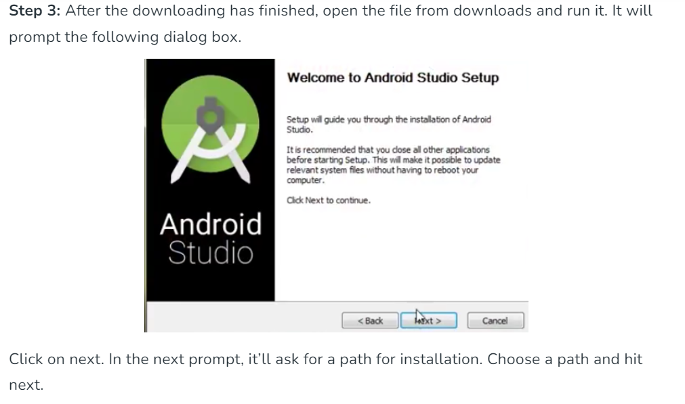

Slide 9
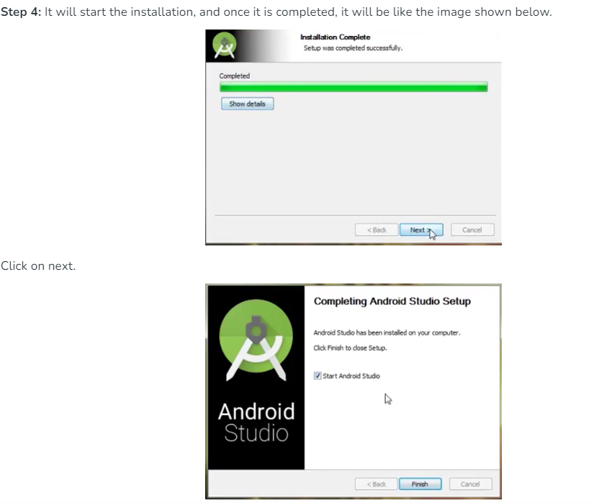

Slide 10
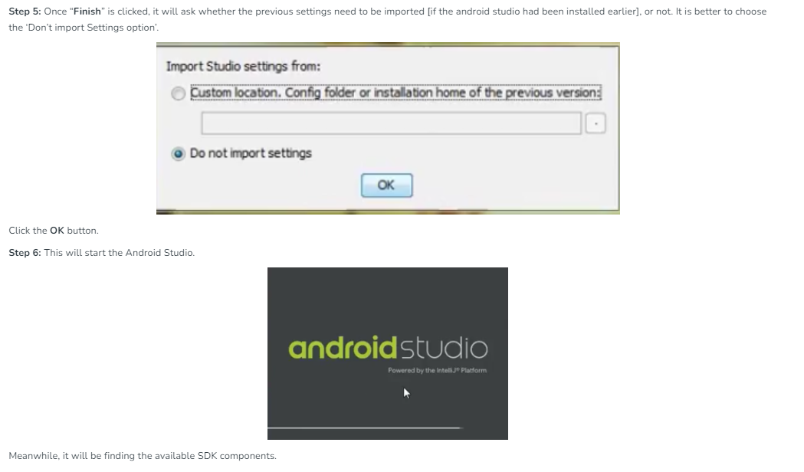

Slide 11
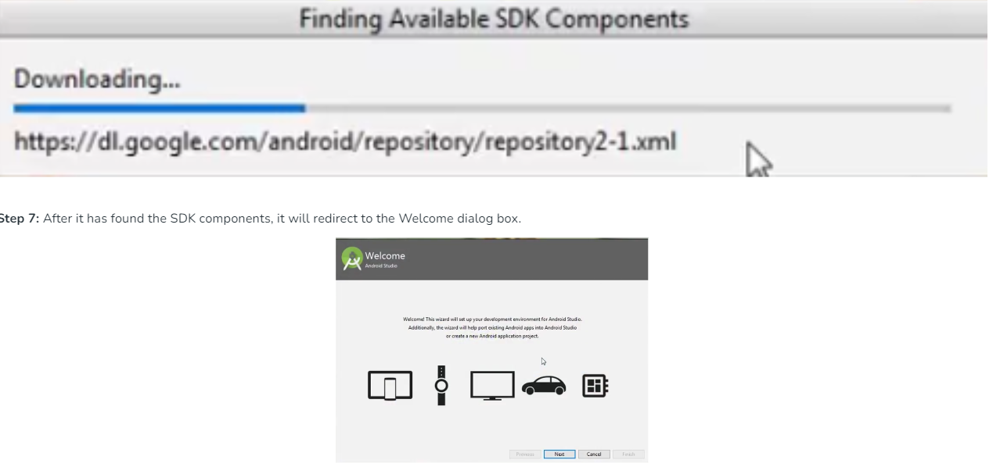

Slide 12
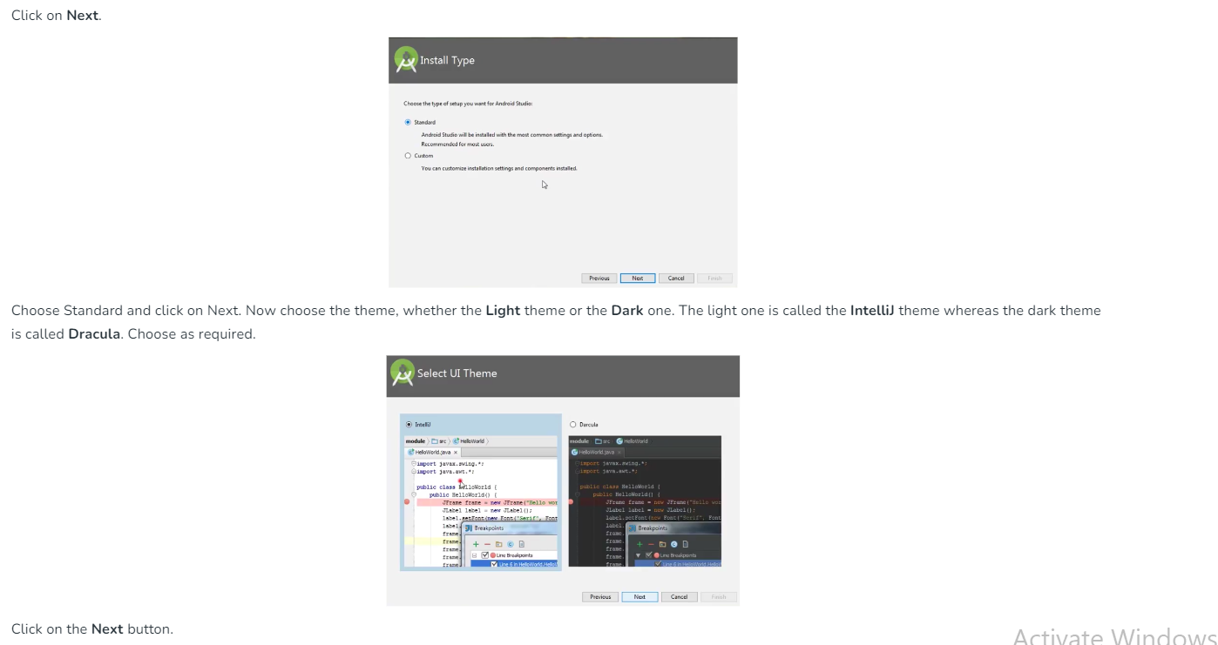

Slide 13
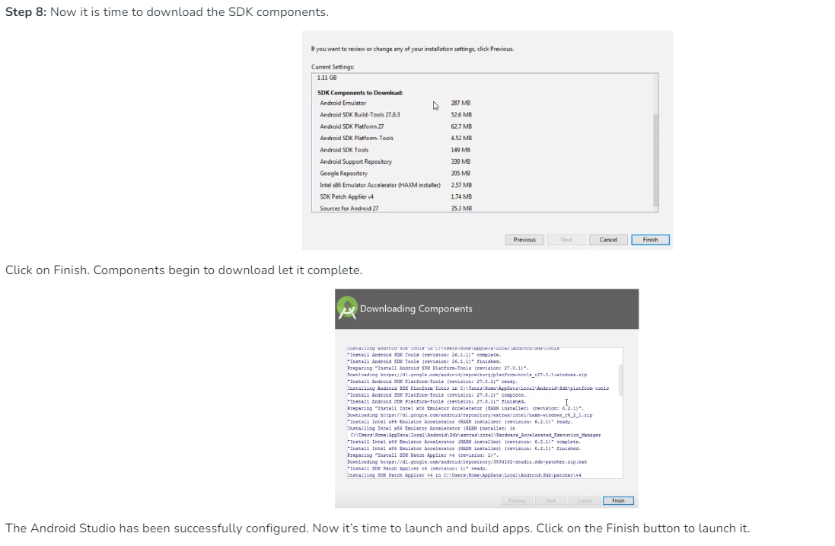

Slide 14
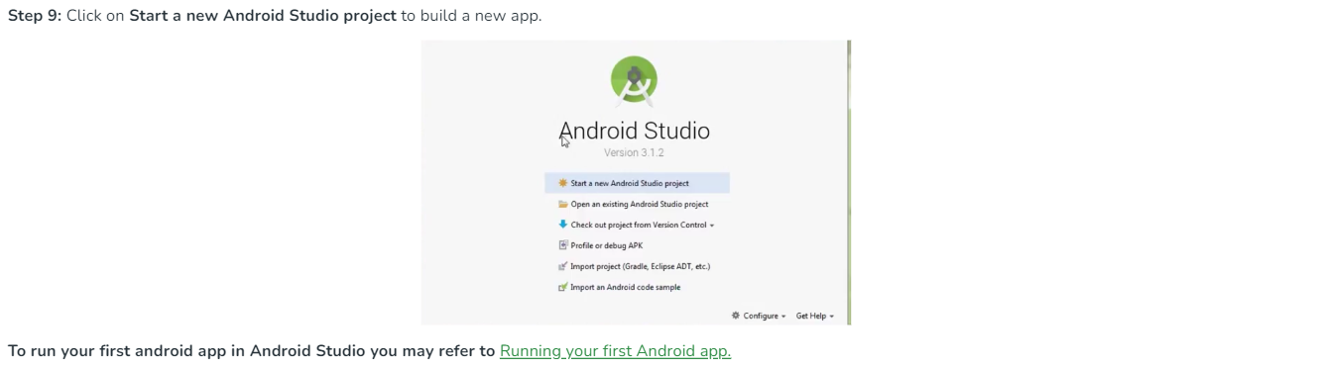

Slide 15
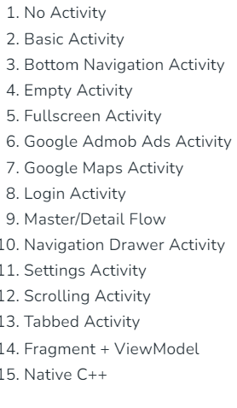
Different types of activities
Generally, when a developer wants to create a new project in the android studio, he/she needs to select a project template which is consisting of many activities as shown in the below image. (Considering that the developer developing the android app for phone and tablet). So, in this article, we are going to discuss what do these activities mean in brief. Here is the list of activities:

Slide 16

Types of activities
Empty Activity: A basic activity with no pre-defined layout or functionality. Developers can customize it according to their app's requirements.
Basic Activity: This template provides a simple layout with a toolbar and a floating action button. It's a good starting point for apps that need a standard user interface with minimal customization.
Fullscreen Activity: This template creates an activity that occupies the entire screen, hiding the system bars. It's suitable for immersive experiences such as games or media players.
Login Activity: This template sets up a basic login screen with input fields for username and password. It's useful for apps that require user authentication.
Navigation Drawer Activity: This template creates an activity with a navigation drawer, allowing users to access different sections or features of the app from a sliding menu.
Bottom Navigation Activity: This template sets up an activity with a bottom navigation bar, providing quick access to different app destinations.
Tabbed Activity: This template creates an activity with tabs, allowing users to switch between different content sections or views.
Master/Detail Flow: This template sets up a master/detail interface, commonly used for displaying lists of items and their details in a two-pane layout on tablets or larger screens.
Settings Activity: This template creates an activity for app settings, providing a standard interface for users to customize app preferences.
Google Maps Activity: This template sets up an activity with a Google Maps fragment, making it easy to integrate maps and location-based features into an app.

Slide 17
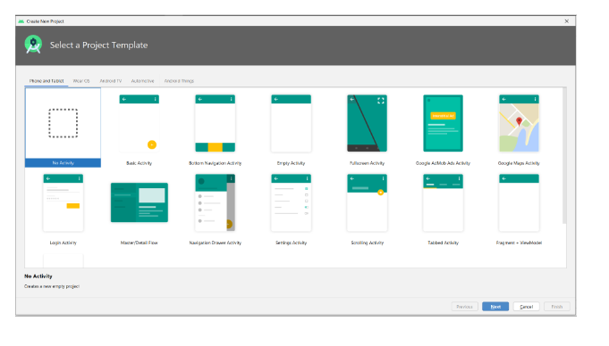

Slide 18
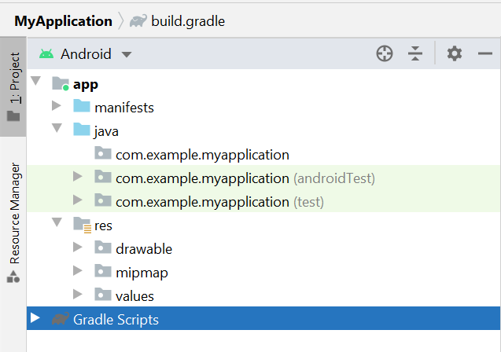
No activity

Slide 19
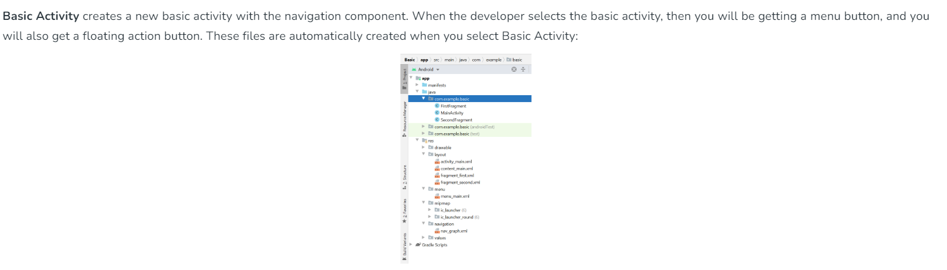
Basic activity

Slide 20
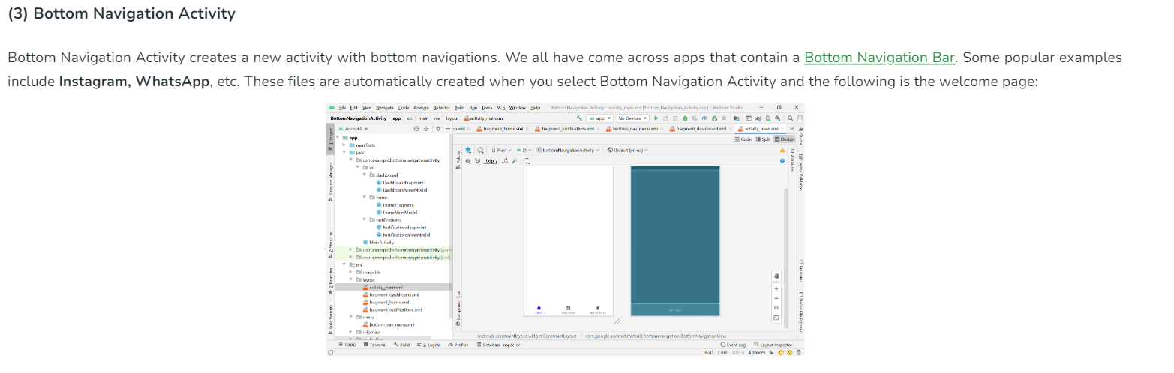
Bottom navigation activity

Slide 21
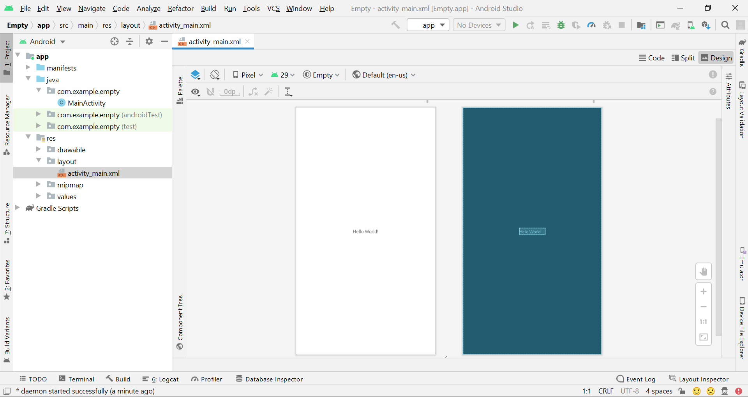
Empty activity

Slide 22
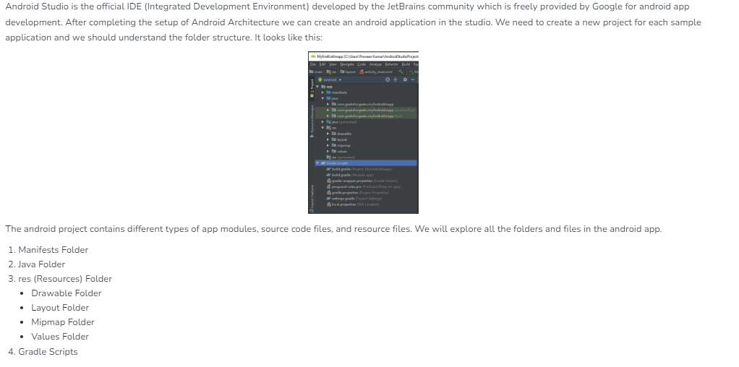
Android file structure

Slide 23
Android file structure
Manifests Folder: Contains the AndroidManifest.xml file that includes information about the app, such as permissions, activities, services, etc.
Java Folder: Holds Java source code files where the main programming is done for the application.
res (Resources) Folder: This folder contains drawable, layout, mipmap, and values subfolders:
Drawable Folder: Stores images and other drawable resources like shapes and colors.
Layout Folder: Contains XML files that define UI layouts for different activities or parts of the app.
Mipmap Folder: Used to store multiple versions of icons to support devices with different screen densities.
Values Folder: Holds XML files that store simple values like strings, integers, colors etc.
Gradle Scripts: Contains build-related files including build.gradle which are used to configure build settings for your project.

Slide 24

Manifest file
Every project in Android includes a Manifest XML file, which is AndroidManifest.xml, located in the root directory of its project hierarchy. The manifest file is an important part of our app because it defines the structure and metadata of our application, its components, and its requirements. This file includes nodes for each of the Activities, Services, Content Providers, and Broadcast Receivers that make the application, and using Intent Filters and Permissions determines how they coordinate with each other and other applications.
The manifest file also specifies the application metadata, which includes its icon, version number, themes, etc., and additional top-level nodes can specify any required permissions, and unit tests, and define hardware, screen, or platform requirements. The manifest comprises a root manifest tag with a package attribute set to the project’s package. It should also include an xmls:android attribute that will supply several system attributes used within the file. We use the versionCode attribute is used to define the current application version in the form of an integer that increments itself with the iteration of the version due to update. Also, the versionName attribute is used to specify a public version that will be displayed to the users.

Slide 25
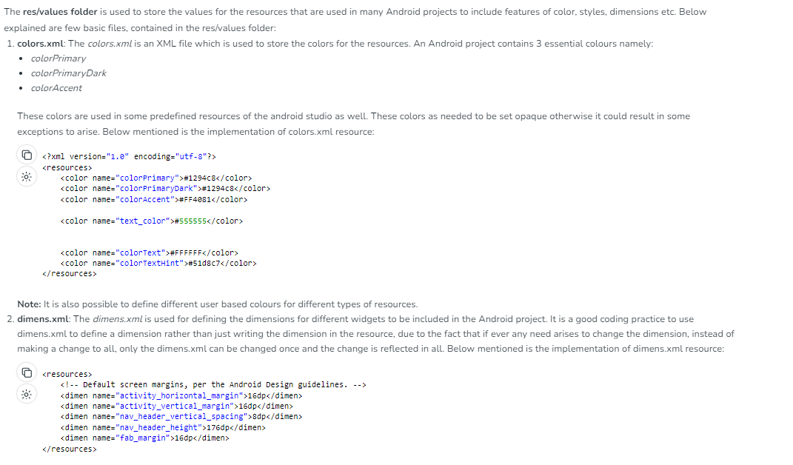
Android | res/values folder

Slide 26
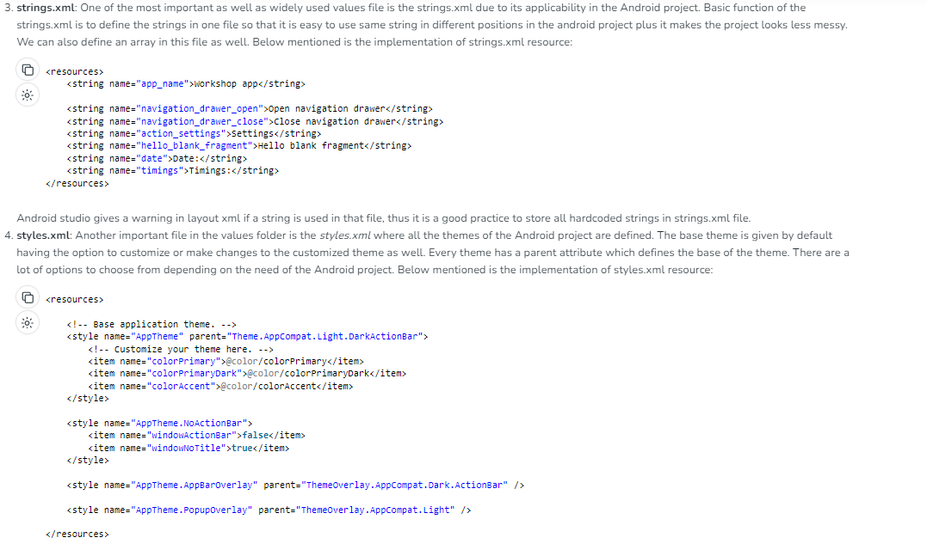

Slide 27
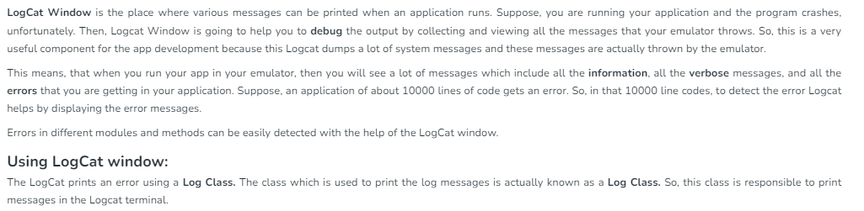
Logcat windows in android studio

Slide 28
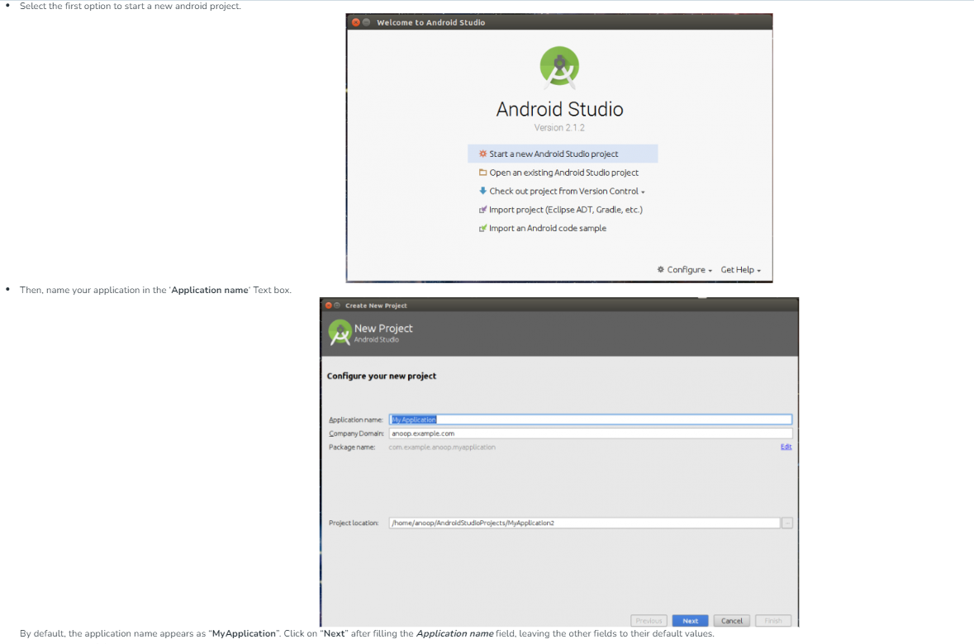
How to Create new project

Slide 29
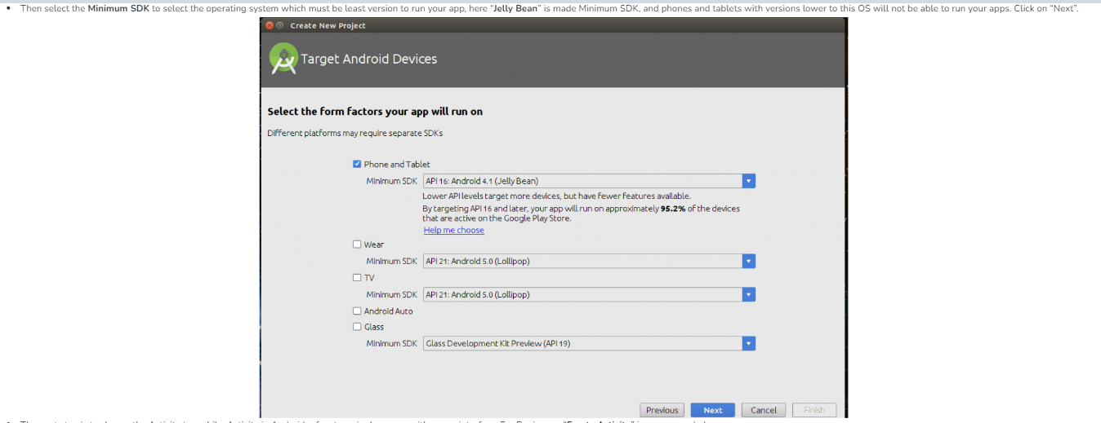

Slide 30
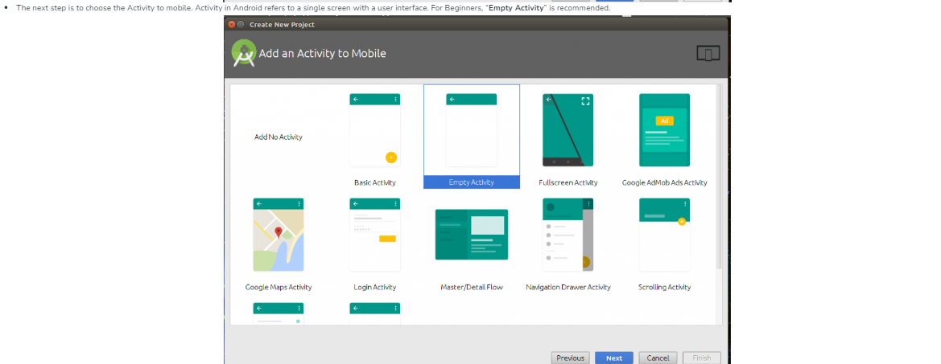

Slide 31
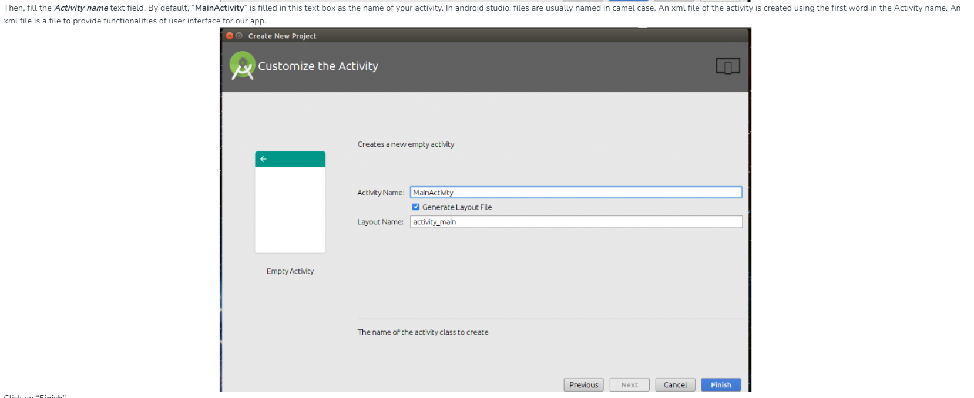

Slide 32
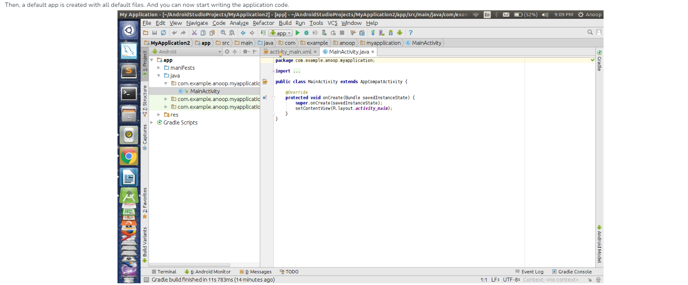

Slide 33
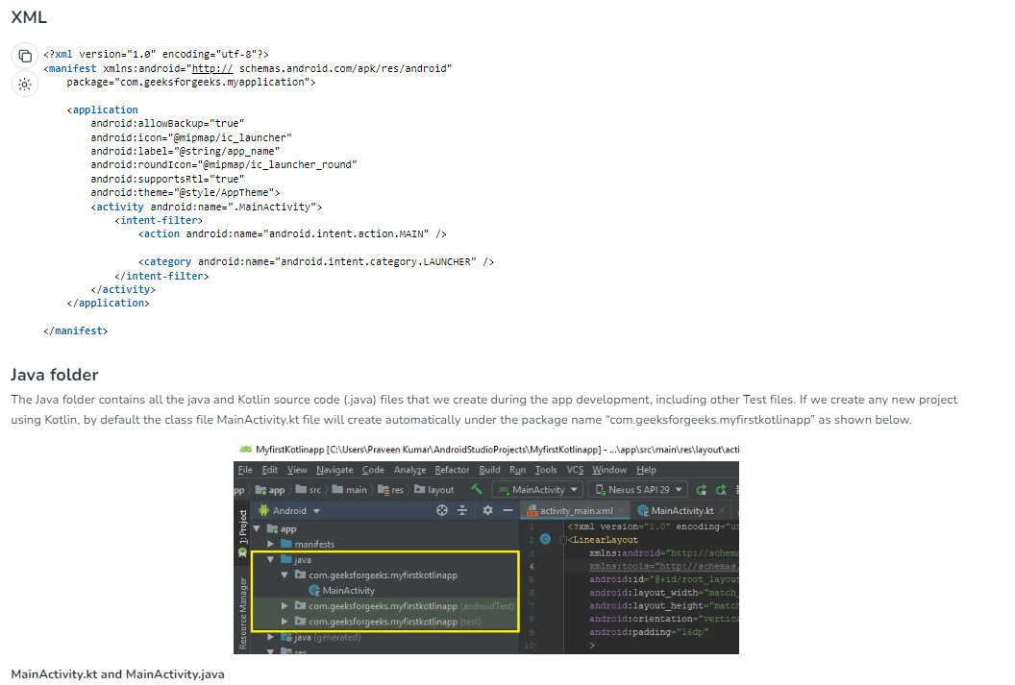

Slide 34
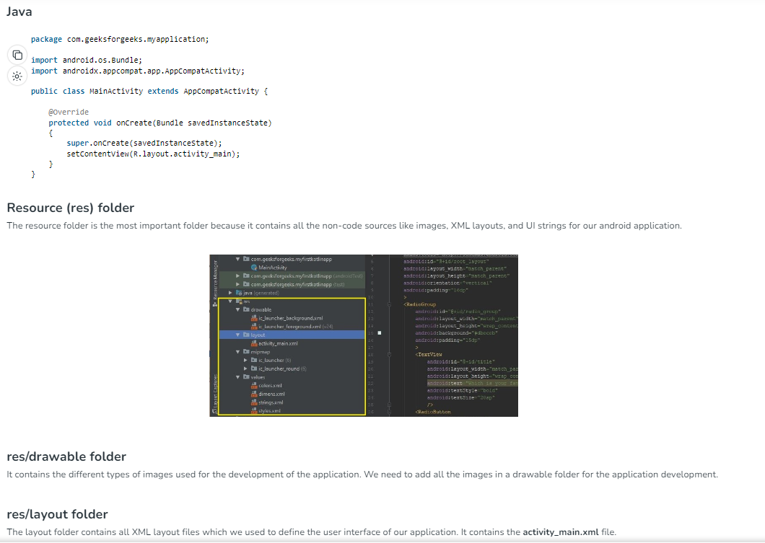

Slide 35
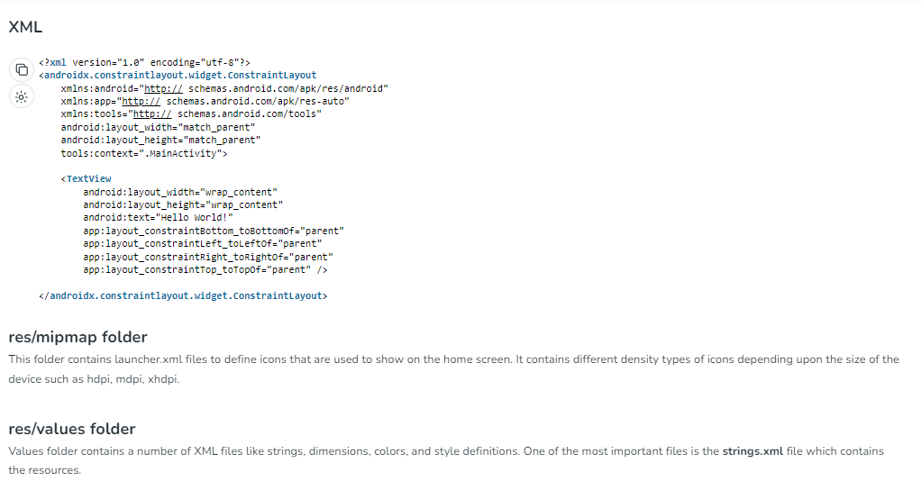

Slide 36
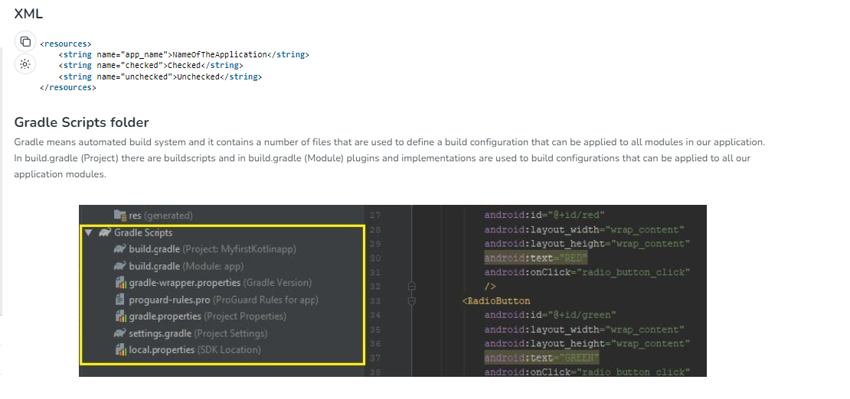

Slide 37
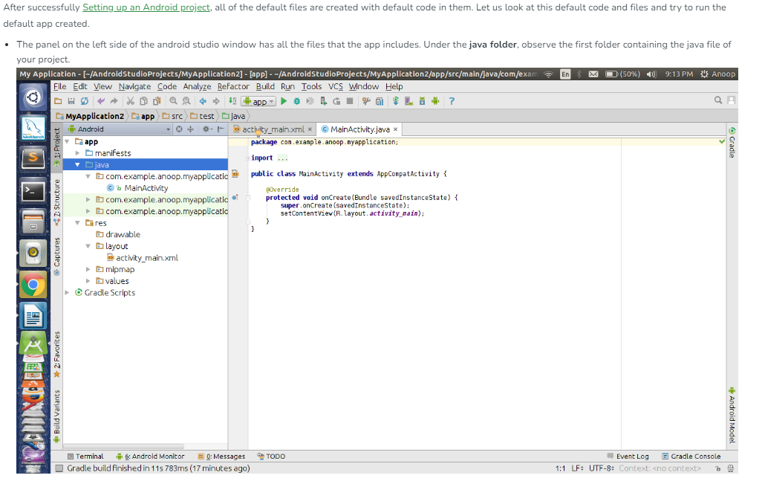
First program in android studio

Slide 38
Continue:
For every activity, a “.java” file and a “.xml” file is created. In this case for MainActivity, “MainActivity.java” and “activity_main.xml” are created.The above java file shows us the default code that is present when an app is created. An activity is created that extends AppCompactActivity class.
The “res” folder contains “layout” subfolder, which includes the xml files of the projects.

Slide 39
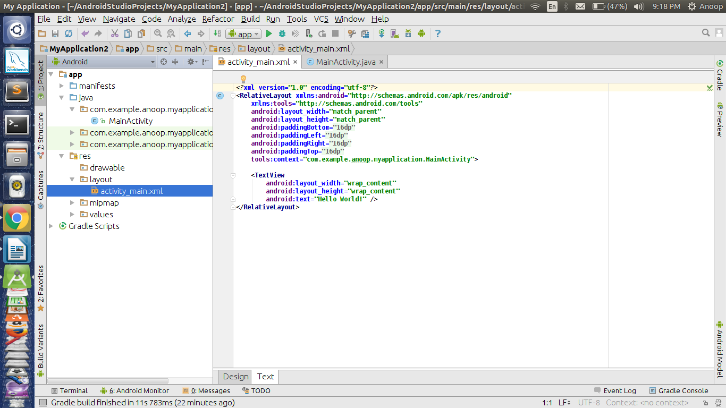

Slide 40
You can find the activity_main.xml file under the layout folder. This the XML file corresponding to the MainActivity. There is an onCreate function that overrides a function of AppCompactActivity class. onCreate(Bundle) is where you initialize your activity. When the activity is first started, then onCreate() methods are called. But after the first start of Activity, the onCreate() of application will not be called for subsequent runs.
Now, consider the activity_main.xml file, it contains various tags similar to HTML. The first tag ensures the version. The second tag is usually the Layout tag. There are various types of Layouts but for now, let us go with the default RelativeLayout. This is a layout that places the widgets relative to screen size.There is a TextView widget by default. This “TextView” is basically the Text field that displays the text specified. It has various attributes. For now, consider the default attributes present. The layout_width and layout_height are the width and height of the widget occupied in the screen. The attribute “wrap_content” refers to width or height being restricted to the content of the text.
The text attribute takes a string in quotations ( i.e., “ ” ). The content within this is displayed on the screen.

Slide 41
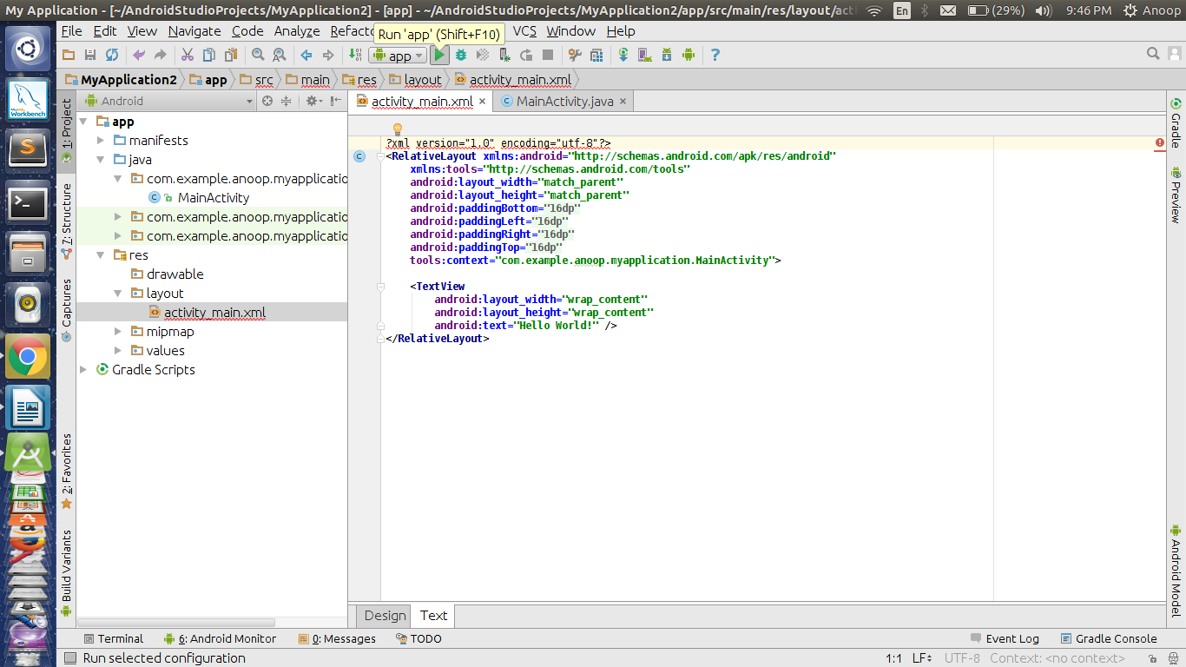

Slide 42
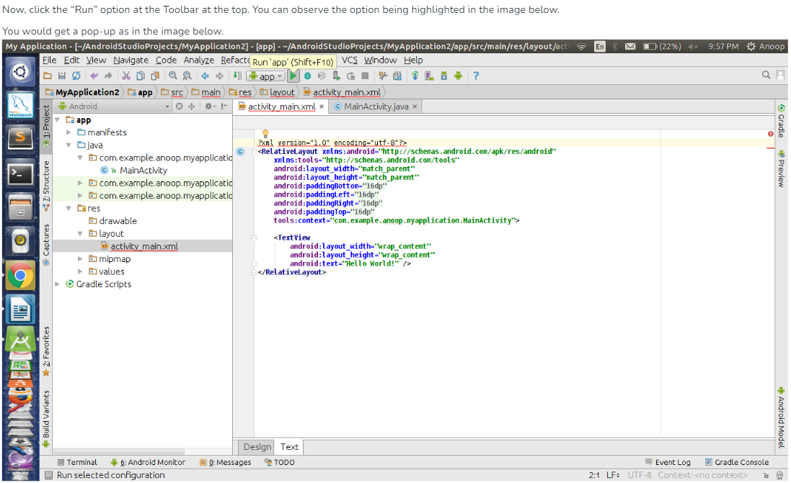

Slide 43
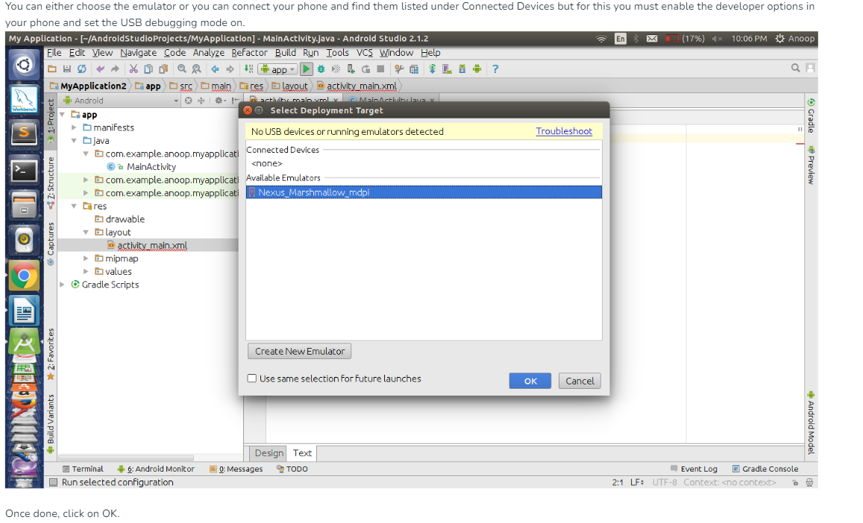

Slide 44
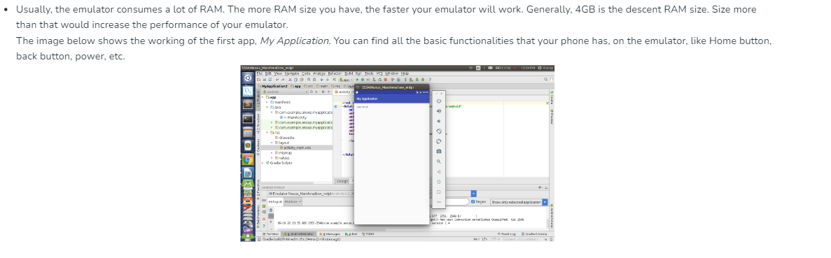

Slide 45
task
Setup Android Studio on your system
Create a birthday Card Android App using Android Studio in Java language.

